Slide 1
Java Type Casting, upcasting, downcasting, type casting with different types of data types
-Pranali chougule

Slide 2
Type casting
Type casting in Java is the process of converting a variable from one data type to another.
Type casting is essential when you need to work with different data types in Java, especially when handling values in expressions or performing calculations across varying data types.
Why Type Casting is Used
To handle operations across different types of variables.
To utilize polymorphism in object-oriented programming, where one object can be referenced as a different type in the class hierarchy.
To avoid data loss when converting between data types, or to intentionally manage the data type (such as rounding or truncating values).

Slide 3
Type Casting Types
Java supports two primary kinds of type casting:
1. Primitive Type Casting
Implicit (Widening) Casting:
Happens automatically when converting from a smaller data type to a larger data type (e.g., int to double).No data loss occurs in widening casting Example: int to double, char to int.
Explicit (Narrowing) Casting:
Required when converting from a larger data type to a smaller data type (e.g., double to int).
This casting may lead to data loss or truncation, so it must be done explicitly.
2. Reference Type Casting
Reference type casting deals with objects and typically involves upcasting and downcasting in inheritance hierarchies.

Slide 4
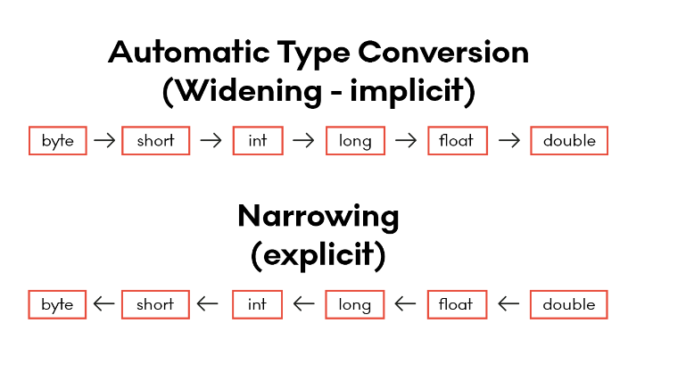

Slide 5
Upcasting
Upcasting is the process of casting a subclass (child) type to a superclass (parent) type. This casting is implicit and is generally safe because a subclass instance "is-a" superclass instance, and Java allows this conversion automatically.
Characteristics of Upcasting:
Implicit: Upcasting happens automatically without the need for explicit casting.
Restricted Access: Once upcast, only the methods and properties of the superclass are accessible, even though the object is still an instance of the subclass.

Slide 6
Example
class Instrument {
void play() {
System.out.println("Playing an instrument.");
}
}
class Guitar extends Instrument {
void play() {
System.out.println("Strumming the guitar.");
}
void tuneStrings() {
System.out.println("Tuning the guitar strings.");
}
}
public class Main {
public static void main(String[] args) {
// Upcasting: Converting Guitar to Instrument
Instrument myInstrument = new Guitar(); myInstrument.play();
// Calls Guitar's play() due to method overriding
// myInstrument.tuneStrings(); // Compile-time error: method not accessible
}
}

Slide 7
Downcasting
Downcasting is the opposite process: casting a superclass (parent) type back to a subclass (child) type. This casting is explicit and can be risky because not all Animal instances are Dog instances. If the object is not truly of the subclass type, a ClassCastException will occur.
Characteristics of Downcasting:
Explicit: Downcasting requires explicit casting using the (Subclass) syntax.
Risky: Downcasting is only safe if the object is actually an instance of the subclass. Otherwise, it throws a ClassCastException.
Instanceof Check: It is common to use the instanceof operator to check if the object is of the specific subclass type before downcasting to avoid runtime exceptions.

Slide 8
Example
class Animal {
void makeSound() {
System.out.println("Animal makes a sound.");
}
}
class Bird extends Animal {
void makeSound() {
System.out.println("Bird chirps.");
}
void fly() {
System.out.println("Bird is flying.");
}
}
public class Main {
public static void main(String[] args) {
// Create an Animal reference that points to a Bird object
Animal myAnimal = new Bird(); // Upcasting to Animal
// Downcasting: Convert the Animal reference back to Bird
if (myAnimal instanceof Bird) {
Bird myBird = (Bird) myAnimal; // Downcasting
myBird.makeSound(); // Calls Bird's makeSound()
myBird.fly();
// Now we can access fly() specific to Bird
}
}
}

Slide 9
Type casting with different data types
Type casting can be done across different data types like int, float, double, char, etc.
Primitive Type Casting Examples
1. Casting from int to float: 2. Casting from double to int:
Converting int or long to float or double is done automatically..
double d = 123.45;
int i = (int) d; // Explicit casting, results in data loss (i becomes 123)
int num = 100;
float f = num; // Implicit casting from int to float

Slide 10
3. Casting from char to int:
4. Casting from int to char :
It converts the integer to the corresponding Unicode character
char c = 'A';
int asciiValue = (int) c; // Explicit casting, ASCII value of 'A' is 65
int asciiValue = 65;
char letter = (char) asciiValue; // int to char
System.out.println(letter); // Output: A
5. Casting from Floating-point to Integer :
Casting float or double to int truncates the decimal part and retains only the integer part.
float decimalNum = 45.67f;
int intNum = (int) decimalNum; // float to int
System.out.println(intNum); // Output: 45

